Slide 1
Faculty of Mathematics and Physics
Charles University
Introduction to Game User Experience
Lecture 4

Slide 2
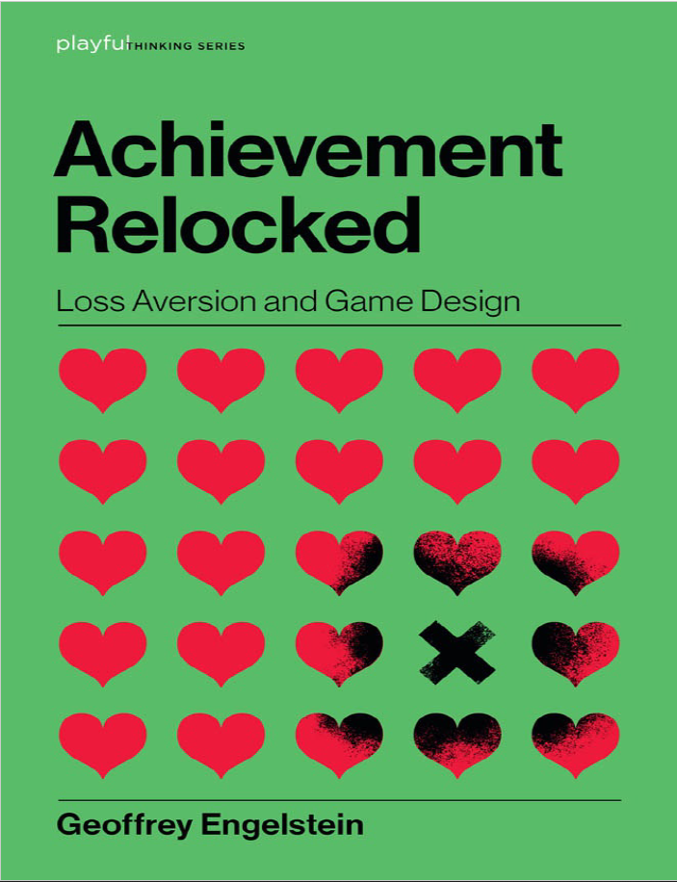
Loss Aversion

Slide 3
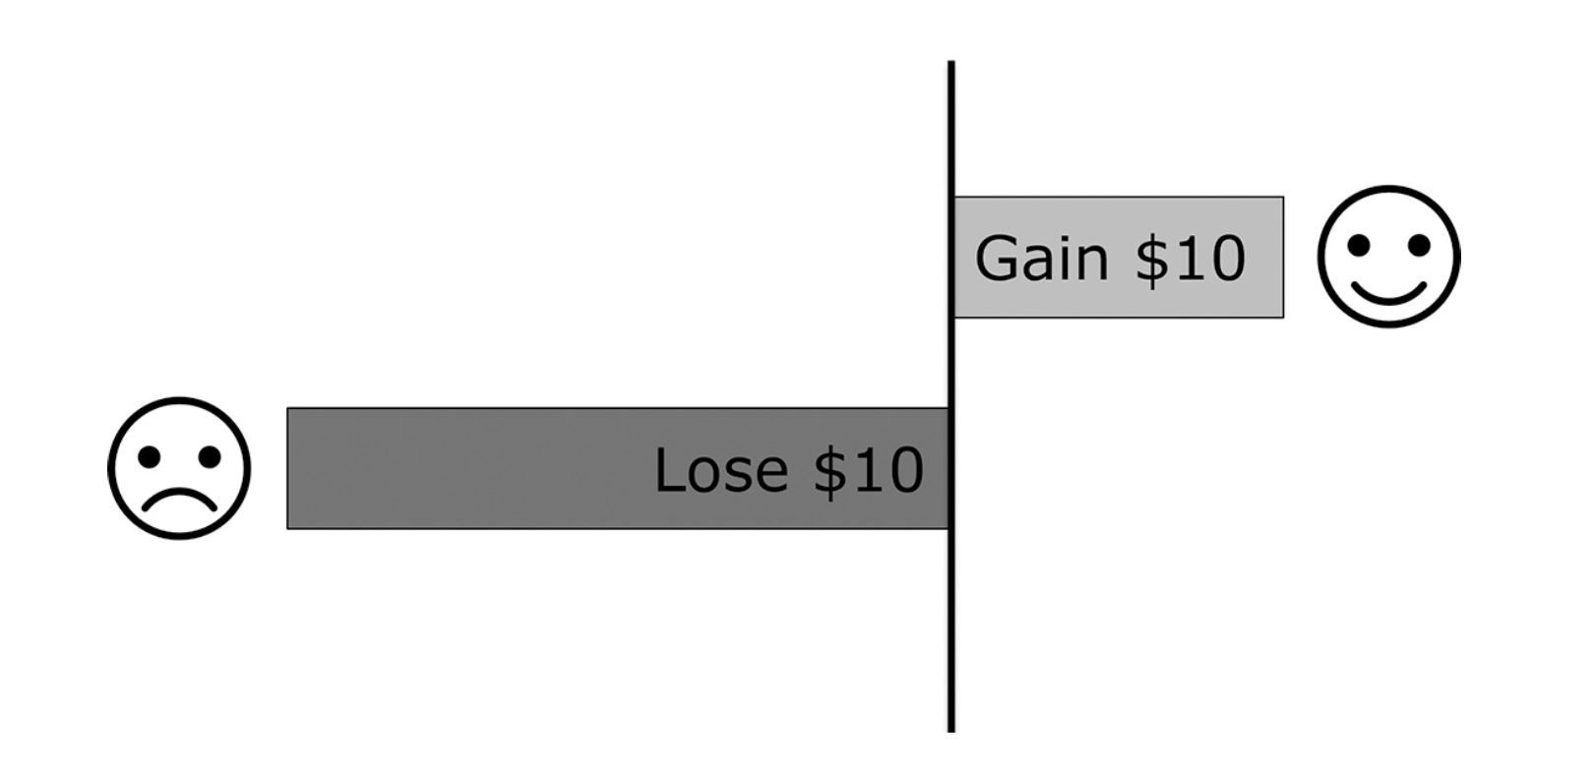
Loss Aversion
1. Getting something makes you feel good
2. Loosing something makes you feel bad
3. Loosing something makes you feel worse than gaining the same thing makes you feel good.

Slide 4
Shared Document
Let‘s go to the g-doc https://docs.google.com/spreadsheets/d/1S224KOCIWKzA_WloW1wx3kx8IBXlc33VQ1ihAeZIDoY/edit?usp=sharing
(Link in the Discord)

Slide 5
Example 1
OPTION A:
an 80 % chance of winning 4,000 USD and a 20 % chance of winning nothing
OPTION B
An 100 percent chance of winning 3,000 USD

Slide 6
Example 2
OPTION C:
An 80 percent chance of losing $4,000 and a 20 percent chance of losing nothing.
OPTION D
An 100 percent chance of losing 3,000 USD

Slide 7
Takeaway
The prospect of losing something weighs more heavily in our decision-making than the prospect of gaining something.
People prefer a sure gain over a gamble for a larger gain, but they will gamble to avoid a sure loss.
Loss Aversion is a key part of the psychology of games

Slide 8
Example 3 and 4
OPTION A:
A 0.2 percent chance to win $3,000.
OPTION B
A 0.1 percent chance to win $6,000.
--------------------------------------------------------------------
OPTION C:
A 0.2 percent chance to lose $3,000.
OPTION D
A 0.1 percent chance to lose $6,000

Slide 9
Example 1
OPTION A:
an 80 % chance of winning 4,000 USD and a 20 % chance of winning nothing
OPTION B
An 100 percent chance of winning 3,000 USD

Slide 10
Example 5
OPTION A:
an 99 % chance of winning 4,000 USD and a 1 % chance of winning nothing
OPTION B
An 100 percent chance of winning 3,000 USD

Slide 11
Takeaway
When chances are low, people will gamble for a bigger win and will accept a slightly higher risk to avoid a big loss
The brain sees 0.1 percent and 0.2 percent as the same thing
Both 100 % and 0 % are special

Slide 12
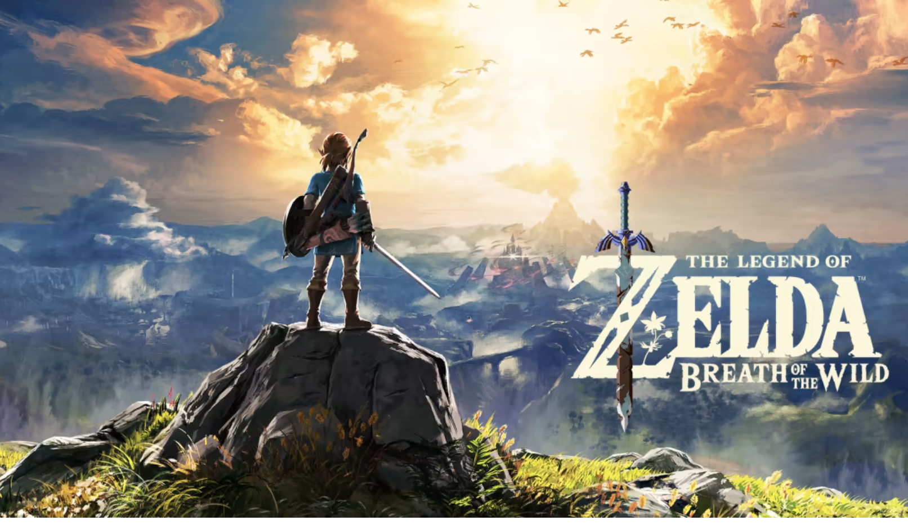
Application to games

Slide 13

Casino Games
Source: ceskatelevize.cz

Slide 14
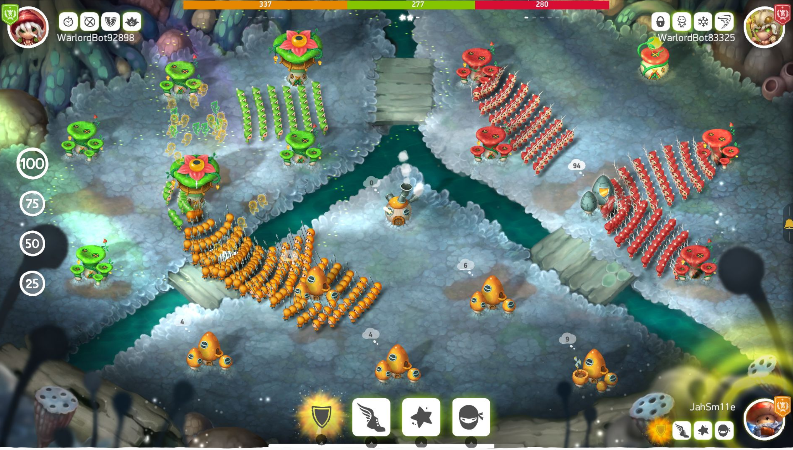
Mushroom Wars 2
Source: ceskatelevize.cz

Slide 15
Mushroom Wars 2
Source: ceskatelevize.cz

Slide 16
Source: ceskatelevize.cz

Slide 17
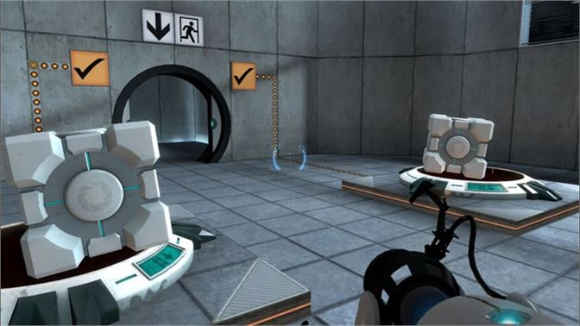
Endowment Effect
Portal 1
(2007, Valve)
Source: ceskatelevize.cz
Notes:
You euthanized your faithful Companion Cube more quickly than any test subject on record.
Congratulations!” You euthanized your faithful Companion Cube more quickly than any test subject on record.
Congratulations!”

Slide 18
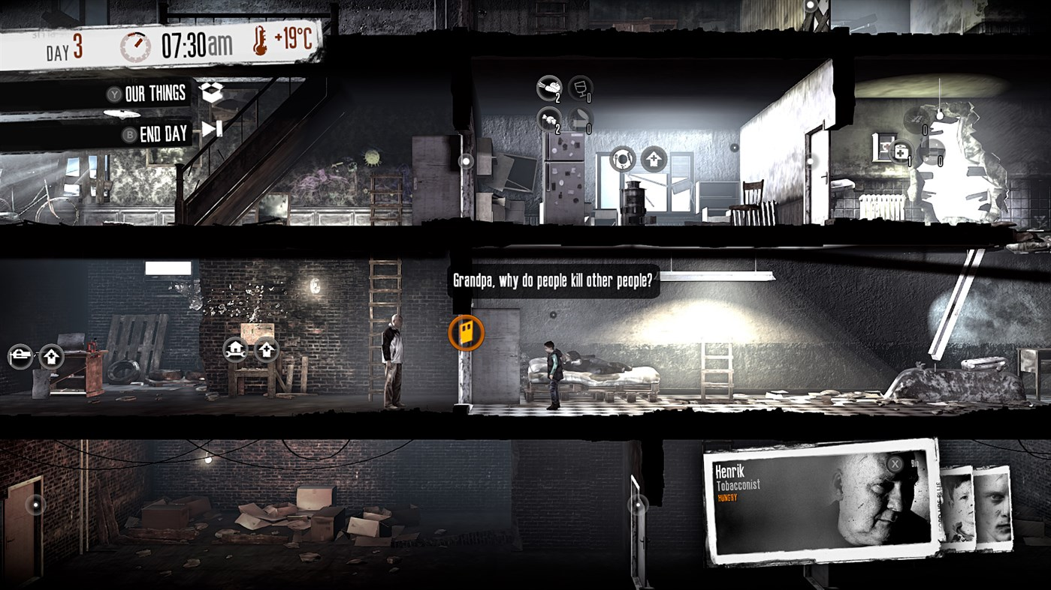
Permadeath
This War of Mine
(2016, 11 Bit Studios )
Notes:
You euthanized your faithful Companion Cube more quickly than any test subject on record.
Congratulations!” You euthanized your faithful Companion Cube more quickly than any test subject on record.
Congratulations!”

Slide 19
Framing
A deadly disease is rapidly spreading! If nothing is done, six hundred people will die.
You are the leader of the Pandemic Response Team and are presented with two options:
OPTION A:
Two hundred people will be saved
OPTION B
One in three chance that all six hundred are saved.
Two in three chance that no people are saved.

Slide 20
Framing
A deadly disease is rapidly spreading! If nothing is done, six hundred people will die.
You are the leader of the Pandemic Response Team and are presented with two options:
OPTION A:
Four hundred people will die.
OPTION B
One in three chance that no one dies.
Two in three chance that six hundred die.

Slide 21
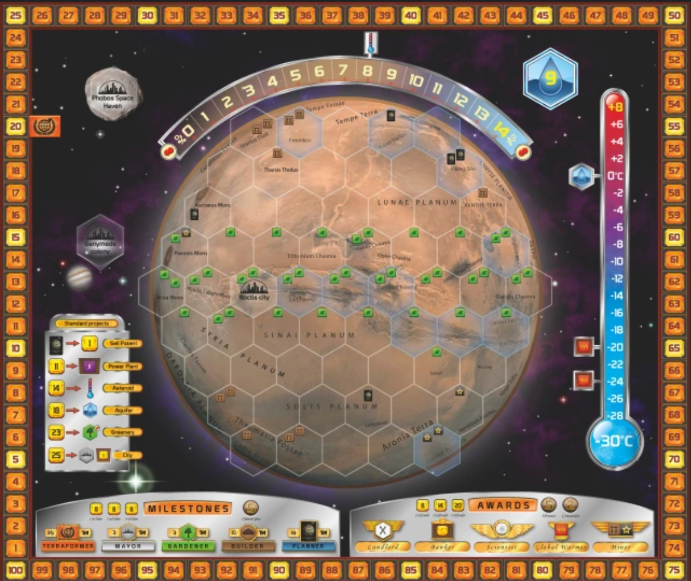
Framing
Terraforming Mars
(Mindok)
Notes:
You euthanized your faithful Companion Cube more quickly than any test subject on record.
Congratulations!” You euthanized your faithful Companion Cube more quickly than any test subject on record.
Congratulations!”

Slide 22
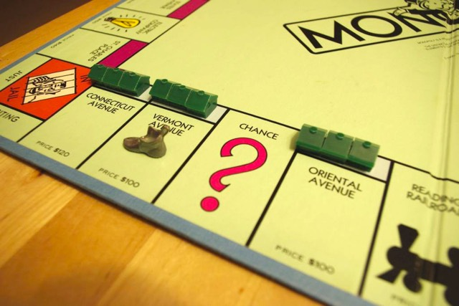
Framing
Monopoly, board game
(1935)

Slide 23
Utility theory
OPTION A:
A 99.9 percent chance of winning $4 billion and a 0.1 percent chance of winning nothing.
OPTION B
A 100 percent chance of winning $3 billion.

Slide 24

Endowed Progress
Source: Albert.cz

Slide 25
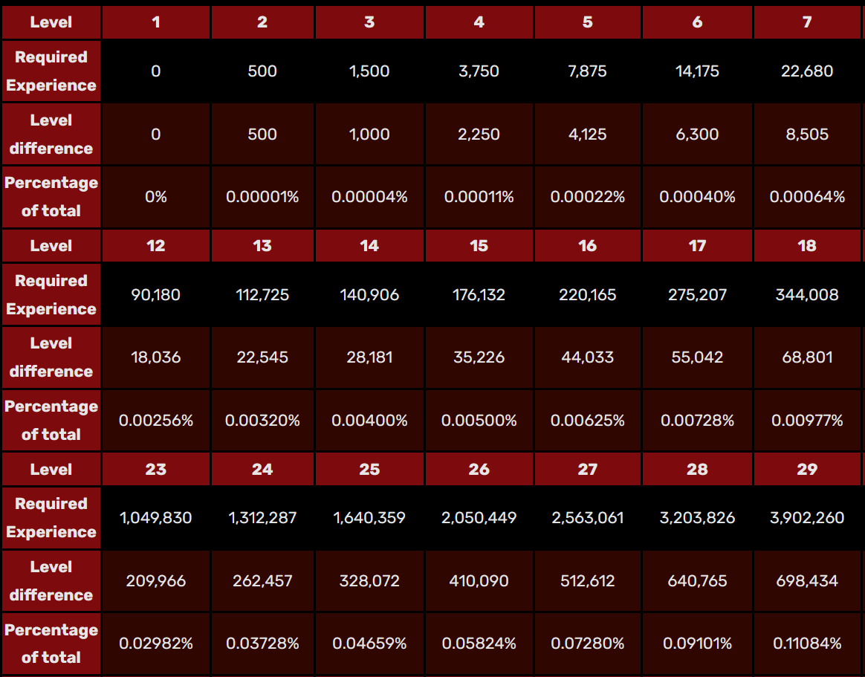
Endowed Progress
Source: https://diablo.fandom.com/wiki/Character_Level

Slide 26
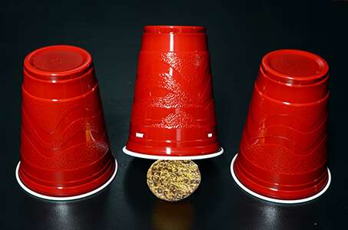
Regret and competence

Slide 27
Summary
Loss aversion + application to games
How related to game currency?
Endowment Effect
Permadeath
Framing
Utility theory
Endowed Progress
Regret + competence
Why is it useful?

Slide 28
Faculty of Mathematics and Physics
Charles University
In case of questions:
kolek@ksvi.mff.cuni.cz
Stay in touch on Discord

